Slide 1


Machine Learning
Dr. Smriti H Bhandari
Department of Computer Science and Engineering

Slide 2
# 40
Machine Learning – 1CSPC315
Unit 4
Probability and Bayes Learning
Dr. Smriti H Bhandari
Department of Computer Science and Engineering

Slide 3
Contents
Probability Concepts
Bayes Theorem
Bayesian Learning
  Bayes Optimal Classifier
  Gibbs Algorithm
Naïve Bayes Classifier
Bayesian Network

Slide 4
Probability - Revisited
Event
  The outcome of a random experiment
  E.g. rewrer
    Getting a heads when we toss a coin is an event
    Getting a 6 when we roll a fair die is an event
Sample space
  The collectioren of all possible outcomes of an experiment

Slide 5
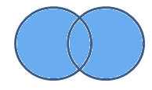
Union
We can define an event (C) of getting a 4 or 6 when we roll a fair die.
Here event C is a union of two events:
Event A = Getting a 4
Event B = Getting a 6
P (C) = P (A ∪ B)

Slide 6
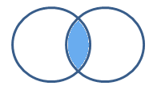
Intersection of Events
Let C be the event of getting a multiple of 2 and 3 when you throw a fair die
Event A = Getting a multiple of 2 when you throw a fair die
Event B = Getting a multiple of 3 when you throw a fair die
Event C = Getting a multiple of 2 and 3
Event C is an intersection of event A & B
Probabilities are then defined as follows:
  P (C) = P (A ∩ B)

Slide 7

Disjoint Events
When any two particular events cannot occur at the same time.
Example: Let’s say you have a fair die and you have only one throw
Event A = Getting a multiple of 3
Event B = Getting a multiple of 5
You want both event A and B should occur together
Let’s find the sub space for Event A & B.
Sample Space = {1,2,3,4,5,6}
Sub space of Event A = {3,6}
Sub space of Event B = {5}
There is no case for which event A & B can occur together. Such events are called disjoint events.

Slide 8
Independent Events
Suppose we have two events – event A and event B.
If the occurrence of event A doesn’t affect the occurrence of event B, these events are called independent events.
Examples
  Getting heads after tossing a coin AND getting a 5 on a throw of a fair die.
  Choosing a marble from a jar AND getting heads after tossing a coin.
  Choosing a 3 card from a deck of cards, replacing it, AND then choosing an ace as the second card.
  Rolling a 4 on a fair die, AND then rolling a 1 on a second roll of the die.
In each of these cases the probability of outcome of the second event is not affected at all by the outcome of the first event.

Slide 9
Probability of independent events
Probability of P (A ∩ B) = P (A) * P (B)
Example: Suppose we win the game if we pick a red marble from a jar containing 4 red and 3 black marbles and we get heads on the toss of a coin. What is the probability of winning?
Event A = getting red marble from the jar
Event B = getting heads on the toss of a coin
We need to find the probability of both getting a red marble and a heads in a coin toss.
P (A) = 4/7, P (B) = 1/2
We know that there is no affect of the color of the marble on the outcome of the coin toss.
P (A ∩ B) = P (A) * P (B)
P (A ∩ B) = (4/7) * (1/2) = (2/7)

Slide 10
Probability of dependent events
Event A = getting a Red marble from the jar. We then keep the marble out and then take another marble from the jar.
Will the probabilities in the second case still be the same as that in the first case?
For the first time there are 4/7 chances of getting a red marble.
  Let’s assume you got a red marble on the first attempt. Now, for second chance, to get a red marble we have 3/6 chances.
  If we didn’t get a red marble on the first attempt but a black marble instead. Then, there were 4/6 chances to get the red marble second time.
  ➔ Therefore the probability in the second case was dependent on what happened the first time.

Slide 11
Machine Learning – 1CSPC315
Unit 4
# 41
Conditional Probability, Bayes Theorem
Dr. Smriti H Bhandari
Department of Computer Science and Engineering

Slide 12
Conditional Probability
Experiments where an outcome of a trial may affect the outcomes of the subsequent trials.
We try to calculate the probability of the second event (event B) given that the first event (event A) has already happened. If the probability of the event changes when we take the first event into consideration, we can safely say that the probability of event B is dependent of the occurrence of event A.
Examples:
  Drawing a second ace from a deck given we got the first ace
  Finding the probability of having a disease given you were tested positive
  Finding the probability of liking Harry Potter given we know the person likes fiction

Slide 13

Conditional Probability
Let us define, 2 events:
  Event A is the probability of the event we’re trying to calculate.
  Event B is the condition that we know or the event that has happened.
  Conditional Probability : P(A|B) ➔ Probability of the occurrence of event A given that B has already happened.

Slide 14
Conditional Probability - Example
Example 1
  Suppose you draw two cards from a deck and you win if you get a jack followed by an ace (without replacement). What is the probability of winning, given we know that you got a jack in the first turn?
  Event A = getting a jack in the first turn
  Event B = getting an ace in the second turn
  Find P(B|A)
P (A) = 4 / 52
P (B) = 4 / 51 { No Replacement }
Probability of winning

Slide 15
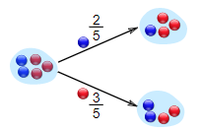
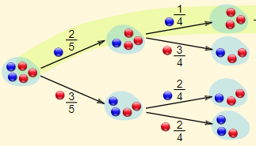
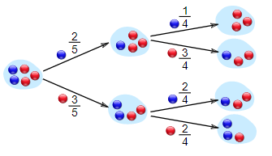
Conditional Probability - Example
Example 2
  Suppose you have a jar containing 5 marbles – 2 blue and 3 red. What is the probability of getting a blue marble given the first one was blue too.
P(A) = Probability of getting a blue marble in the first turn = 2/5
P(B|A) = Probability of getting a blue marble in the second turn having drawn the blue marble in the first turn = 1/4
Find P (A and B) – Probability of getting two blue marbles

Slide 16
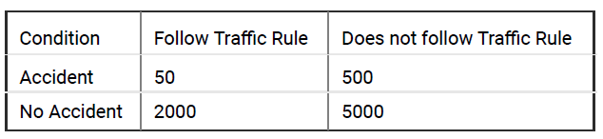
Exercise
A research group collected the yearly data of road accidents with respect to the conditions of following and not following the traffic rules of an accident prone area. They are interested in calculating the probability of accident given that a person followed the traffic rules. The table of the data is given as follows:
Notes:
P(Accident | A person follow Traffic Rule) = P(Accident and follow Traffic Rule) / P(Follow Traffic Rule)
Solution : 0.02439024

Slide 17
Machine Learning – 1CSPC315
# 42
Unit 4
Bayes Theorem and Machine Learning
Dr. Smriti H Bhandari
Department of Computer Science and Engineering

Slide 18
Bayes Theorem
The Bayes theorem describes the probability of an event based on the prior knowledge of the conditions that might be related to the event.
If we know the conditional probability P(A|B), we can use the Bayes rule to find out the reverse probabilities P(B|A).
Bayes Rule

Slide 19
Bayes Theorem
Determining the best hypothesis from some space H, given the observed training data D
Bayes Theorem → to calculate P (h/D)
P ( h / D ) is called posterior probability of h, because it reflects our confidence that h holds after we have seen the training data D.
Probability D given h → If the hypothesis is true, what is the likelihood of that data being generated? If h was true what is the probability of D being generated
Prior probability / initial probability that hypothesis h holds before observing the training data
Probability of observing data D given some hypothesis h that holds
Probability that h holds given the observed training data D.
Prior probability of training data D (i.e. the probability of D given no knowledge about which hypothesis holds)

Slide 20
Choosing Hypothesis
Find h ∈ Η which is most probable given the observed data
Such maximally probable hypothesis is called maximum a posteriori (MAP) hypothesis
P(D) can be omitted because it is a constant independent of h

Slide 21
Maximum likelihood hypothesis
If we assume that every hypothesis in H is equally probable then
P(h_{i}) = P(h_{j}) for all h_{i} and h_{j} in H
The most probable hypothesis h_{ML} is given as
Maximum likelihood hypothesis
→ Hypothesis that maximizes P(D/h)
Likelihood of the Data D given h

Slide 22
Example
A medical diagnosis problem with two alternative hypotheses
  The patient has a particular form of cancer / does not have cancer
Given, over the entire population of people only 0.008 have the disease.
The lab test is only an imperfect indicator of disease. The test returns a correct positive result in only 98% of the cases in which the disease is actually present. It gives correct negative result in only 97% of the cases in which the disease is not present.
New patient is observed for whom lab test returns a positive result. Should we diagnose the patient as having cancer or not?

Slide 23
P(¬cancer) = 0.992
P(- | cancer) = 0.02
P(- | ¬cancer) = 0.97
P(cancer) = 0.008
P(+ | cancer) = 0.98
P(+ | ¬cancer) = 0.03
New patient is observed for whom lab test returns a positive result. Should we diagnose the patient as having cancer or not?
Patient do not have Cancer
Maximum
➔ h_{MAP} = ¬cancer

Slide 24
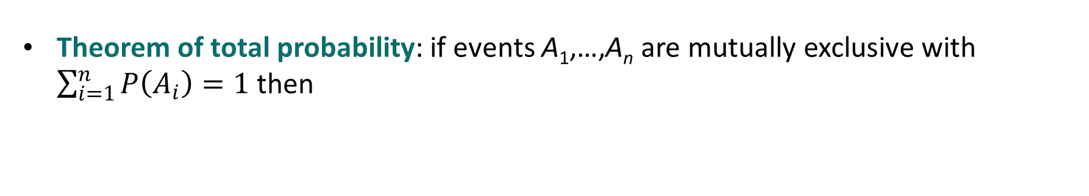
Summary of Basic Probability Formulas
Product rule: probability P(A ∧ B) of a conjunction of two events A and B
Sum rule: probability of disjunction of two events A and B
Bayes theorem: the posterior probability P(h/D) of h given D
Theorem of total probability: if events A₁,…,A_{n} are mutually exclusive with $\sum_{i=1}^{n}{P\left(A_{i}\right)=1}$ then

Slide 25
# 43
Machine Learning – 1CSPC315
Unit 4
Bayes Optimal Classifier
Dr. Smriti H Bhandari
Department of Computer Science and Engineering

Slide 26
Bayes Optimal Classifier
What is the most probable classification of the new instance given the training data?
  Using training data, learn h_{MAP}. So, h_{MAP} is the most probable hypothesis,
Illustration
  Consider hypothesis space containing h₁, h₂, h₃
  Let posterior probabilities given training data are
  P(h₁|D) = 0.4, P(h₂ |D) = 0.3 , P(h₃|D) = 0.3
  Let new instance x is classified as + by h₁, but negative by h₂ and h₃ ➔ As h₁ is most probable hypothesis, new instance x will be classified as “+”
  Considering all hypotheses, the probability that x is + is 0.4 (P(h₁ |D)) and the probability that it is negative is 0.6
  ➔ the most probable classification would be “–” (different from MAP hypothesis)
but whether h_{MAP} is the most probable classification ?
➔ h₁ is the MAP hypothesis

Slide 27
Bayes Optimal Classifier
The most probable classification of the new instance is obtained by combining the predictions of all hypotheses, weighted by their posterior probabilities
v_{j} = possible values / labels of the instances
The optimal classification of the new instance is the value v_{j} for which P(v_{j}|D) is maximum
Bayes Optimal Classification ➔
Example: V = {+, -}
P(h₁|D)=.4, P(-|h₁)=0, P(+|h₁)=1
P(h₂|D)=.3, P(-|h₂)=1, P(+|h₂)=0
P(h₃|D)=.3, P(-|h₃)=1, P(+|h₃)=0
therefore

Slide 28
Machine Learning – 0CSPC307
Unit 4
# 44
Gibbs Classifier
Dr. Smriti H Bhandari
Department of Computer Science and Engineering

Slide 29
Gibbs Classifier
Bayes optimal classifier provides best result, but can be expensive for large number of hypotheses.
Gibbs algorithm – an alternative less optimal method:
  Choose one hypothesis at random, according to P(h|D)
  Use this h to classify new instance
Surprising fact:
  E[error_{Gibbs}] ≤ 2E[error_{BayesOptimal}]
Expected misclassification error is no worse than twice Bayes optimal classifier

Slide 30
Machine Learning – 1CSPC315
# 44
Unit 4
Naïve Bayes Classifier
Dr. Smriti H Bhandari
Department of Computer Science and Engineering

Slide 31
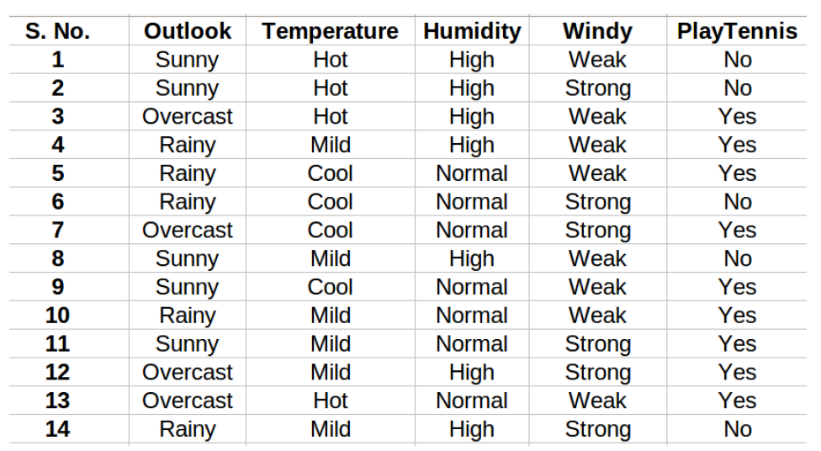
Naïve Bayes Classifier
One of the most practical Bayesian learning methods
When to use
  Moderate or large training set available
  Attributes / features that describe instances are independent of one another and each attribute has equal contribution
Few applications:
  Diagnosis
  Classifying text documents

Slide 32
Naïve Bayes Classifier
Assume target function f: X→ Y, where each instance X is described by attributes (x₁, x₂, … , x_{N}).
Most probable value of f(x) is:
Naïve Bayes assumption gives
Naïve Bayes classifier:

Slide 33
Naïve Bayes Algorithm

Slide 34
# 45
Machine Learning – 1CSPC315
Unit 4
Naïve Bayes Classifier - Example
Dr. Smriti H Bhandari
Department of Computer Science and Engineering

Slide 35
Exercise
Given training data
If new instance today = (Sunny, Hot, Normal, Weak), Predict whether one should play tennis or not ?

Slide 36
Solution
We need to find P(x_{i} | y_{j}) for each x_{i} in X and y_{j} in y.
Considering the first instance in the table where
X = (Sunny, Hot, High, Weak) and y = No
P(y | X) can be interpreted as probability of “Not Playing Tennis” given that weather conditions are “Sunny Outlook”, “Temperature Hot”, “High Humidity” and “Weak wind”
What to compute ?
  For each feature / attribute and for each distinct value estimate probability P (x_{i} | y_{j})
  For each target value estimate probability P(y_{j}) ➔ Class Probabilities

Slide 37
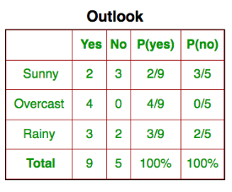
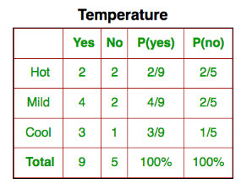
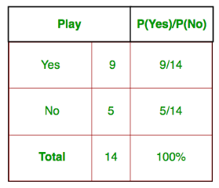
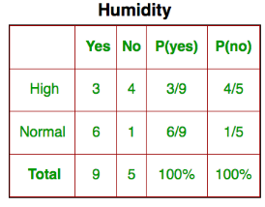
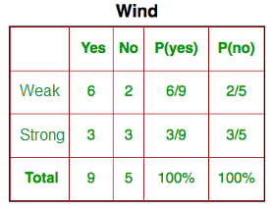
Solution
✓
✗
✗
✓
✓
Class Probabilities
✓
✗
✓
✓
Probability of normal humidity given tennis played.
P(Humidity=Normal | Play Tennis=Yes) = 6/9

Slide 38
Solution
If new instance today = (Sunny, Hot, Normal, Weak), Predict whether one should play tennis or not ?
Y={Yes, No}
Probability of Playing Tennis
Probability of Not Playing Tennis

Slide 39
Solution
If new instance today = (Sunny, Hot, Normal, Weak), Predict whether one should play tennis or not ?
Probability of Playing Tennis
Probability of Not Playing Tennis
Normalization
P(Yes | today) > P(No | today)
➔ Prediction that tennis would be played is “Yes”

Slide 40
Exercise
For the same training data, if new instance day = (Sunny, Cool, High, Strong),
Predict whether one should play tennis or not ?
Notes:
Solution:
P(Yes/day)=0.0053
P(No/day)=0.0206
Prediction : Play Tennis = No

Slide 41
Naïve Bayes Subtleties
Conditional independence assumption is often violated in real-world situations.
  … but it works surprisingly well in practice.
What if none of the training instances with target value y_{j} have attribute value x_{i} ? Then
Typical solution is Bayesian estimate for
  n is number of training examples for which y = y_{j}
  n_{c} is number of examples for which y = y_{j} and x = x_{i}
  p is prior estimate for
  m is weight given to prior (i.e., number of “virtual” examples)

Slide 42
# 45
Machine Learning – 1CSPC315
Unit 4
Bayesian Belief Networks
Dr. Smriti H Bhandari
Department of Computer Science and Engineering

Slide 43
Bayesian Belief Networks
Naïve Bayes assumption of conditional independence is too restrictive
But it is intractable without some such assumptions …
Notes:
As discussed earlier, the naïve Bayes classifier makes significant use of the assumption that the values of the attributes x₁, x₂, … x_{n} are conditionally independent given the target value y. This assumption dramatically reduces the complexity of learning the target function. However, in many cases this conditional independence assumptions is clearly too restrictive.

Slide 44
Bayesian Belief Networks
Type of Probabilistic Graphical Model
  Also known as Bayes Nets
Bayesian belief networks describe conditional independence among subsets of variables
Bayesian belief networks provide an intermediate approach that is less constraining than the global assumption of conditional independence made by the naïve Bayes classifier, but more tractable than avoiding conditional independence assumption altogether.

Slide 45
Bayesian Belief Networks
{ x₁, x₂, …, x_{n} }
Causality
: Cause → Effect
Bayesian network, a probabilistic graphical model comprises of
nodes (representing random variables)
links / edges / arcs (expressing probabilistic relationships between these variables)
x₁
Node
Parent Node
x₂
x₃
Arc
x₄
Child Node
P (X_{i} | Parent (X_{i}) ) ➔ determines the effect of the parent on that node.
Directed Acyclic Graph or DAG
Probability of given Network : P(x₁,x₂,x₃,x₄)=P(x₁)P(x₂|x₁)P(x₃)P(x₄|x₂,x₃)

Slide 46
{ Rainy day, Waking-up late, Traffic jam, Late at Work }
{ Waking-up late, Traffic jam, Late at Work }
Rainy Day
Waking-up Late
Traffic Jam
Parent Node
Arrow represents Dependency
The child node’s occurrence is influenced by the occurrence of its parent node
Late at Work
Child Node

Slide 47
Example
Accident
Rainy Day
Waking-up Late
Traffic Jam
Late at Work
Late for Meeting

Slide 48
Conditional Independence
Definition: X is conditionally independent of Y given Z if the probability distribution governing X is independent of the value of Y given the value of Z; that is, if
  more compactly we write
  P ( X |Y, Z ) = P ( X | Z )
Example:
Getting_Late is conditionally independent of Rainy_Day given Traffic_Jam
P (Getting_Late | Rainy_Day, Traffic_Jam) = P (Getting_Late | Traffic_Jam)
Naïve Bayes uses conditional independence to justify
  P ( x₁, x₂ | y ) = P (x₁ | x₂ , y ) P (x₂ | y )
  = P ( x₁ | y ) P (x₂ | y )
  P (Thunder | Rain, Lightning ) =P ( Thunder | Lightning )
  Thunder is conditionally independent of Rain given Lightning
Product Rule

Slide 49
Bayesian Networks
Based on Joint probability distribution and conditional probability
Joint Probability Distribution
  Assume, we have variables X₁, X₂, X₃,....., X_{n}. Let V(X_{i}) denotes the set of possible values of X_{i}. Then the probabilities of a different combination of values for the tuple of variables (X₁, X₂, X₃,....., X_{n} ) are known as Joint probability distributions.
  P (x₁, x₂, x₃,....., x_{n}) can be written as follows in terms of the joint probability distribution
  = P (x₁ | x₂, x₃,....., x_{n}) P (x₂, x₃,....., x_{n})
  = P (x₁ | x₂, x₃,....., x_{n}) P (x₂ | x₃,....., x_{n}) .... P (x_{n-1} | x_{n}) P (x_{n})
In General,
Set of immediate predecessors of X_{i}

Slide 50
Example
For each variable two types of information are specified.
Arcs → variable is conditionally independent of its non-descendants in the network given its immediate predecessor in the network.
A conditional probability table (CPT) is given for each variable
Accident
Rainy Day
Waking-up Late
Traffic Jam
CPT for Late at Work
 | WL, TJ | WL, ~TJ | ~WL, TJ | ~WL, ~TJ
LW | 0.4 | 0.1 | 0.8 | 0.2
~LW | 0.6 | 0.9 | 0.2 | 0.8
Late at Work
P ( Late_at_Work = True |
Waking_up_Late = True,
Traffic_Jam = True) = 0.4
Late for Meeting

Slide 51
Inference in Bayesian Networks
How can one infer the (probabilities of) values of one or more network variables, given observed values of others ?
If Bayes net contains all information needed / the values of all the variables are known
  Easy to infer the probability distribution for the target variable
If values for only the subset of variables is known, then in general case, problem is NP hard
In practice, two kinds of methods
  Exact inference methods work well for some network structures
  Approximate inference methods such as Monte Carlo methods “simulate” the network randomly to calculate approximate solutions

Slide 52
Learning of Bayesian Networks
Several variants of this learning task
  Network structure might be known or unknown and must be inferred from training data
  Training examples might provide values of all network variables, or just some
If structure known and observe all variables, then it is as easy as training a Naïve Bayes classifier

Slide 53
Learning of Bayesian Networks
Suppose structure known, variables partially observable
e.g., Observe Late_at_work, Accident, Rainy_Day, but not Taraffic_Jam, Late_at_meeting etc.
→ Similar to training neural network with hidden
units
In fact, can learn network conditional probability tables using gradient ascent !
Converge to network h that (locally) maximizes P(D|h)

Slide 54
Gradient Ascent for Bayes Nets
Let w_{ijk} denote one entry in the conditional probability table for variable Y_{i} in the network
w_{ijk} =P(Yi=yij|Parents(Y_{i})=the list u_{ik} of values)
e.g., if Y_{i} = Campfire, then u_{ik} might be (Storm=T, BusTourGroup=F)
Perform gradient ascent by repeatedly
1. Update all w_{ijk} using training data D
2. Then renormalize the w_{ijk} to assure

Slide 55
Applications of Bayesian Networks
Document Classification
Medicine – diagnosis
Information Retrieval
Semantic Search
Image Processing
…..

Slide 56
End of Unit - 4
References :
Tom M. Mitchell, “Machine Learning”, McGraw Hill Education (India) Edition 2013
NPTEL course “Introduction to Machine Learning” by Prof. Sudeshna Sarkar
Few online Resources
Dr. Smriti H Bhandari
Department of Computer Science and Engineering

